Slide 1
HL2027 Project 2 Presentation
Group 2
Louis JOOS
Ramadhani Pamapta PUTRA

Slide 2
Introduction
In surgery planning, finding a tissue or organ in MRI images can be an important step to assess the condition of the patient.
Segmentation of organ is important , so that the organ is quickly located and distinguished with surrounding tissues/organs.
Alternatively, we can design a classifier to predict where a specific organ is located(spatial-wise and slice-wise)

Slide 3
Introduction
By finding a specific tissue instantly and easily, the patient assessment can be less time-consuming.
This would make MRI observation easier for the medical staff.

Slide 4
Experimental Design
We have conducted two experiments :
Atlas-based segmentation of femur and hip bones
Femur head presence prediction along z-slices

Slide 5
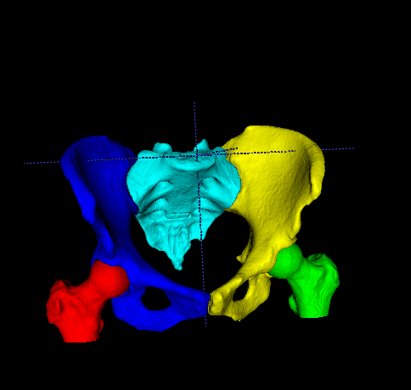
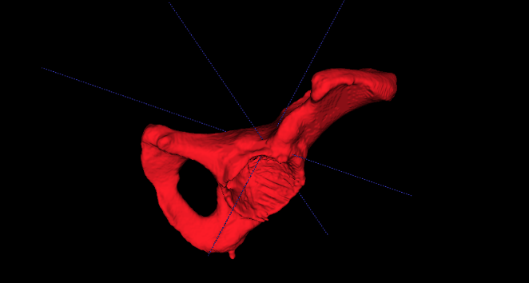
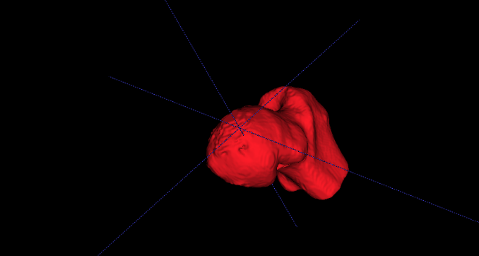
Atlas-based segmentation of femur and hip bones
Masks/Labels by the Students as atlases (3 set MRI Images) consist of femur and hip labels
Masks/Labels by Expert as ground truths (3 set MRI Images)

Slide 6
Atlas-based segmentation of femur and hip bones
3 masks
“Common” images as reference
Linear registration
Apply on atlas masks
Majority
voting
Transforms
Unified mask as segmentation
“Group” images as registering images

Slide 7
Atlas-based segmentation of femur and hip bones
Calculate similarity metrics
Segmentation
results
Output 1
Dice Coefficient
Output 2
Hausdorff Distance
Ground truths

Slide 8
Results
Results hip: | Image 40 |  | Image 41 |  | Image 42
 | Left bone | Right bone | Left bone | Right bone | Left bone | Right bone
Dice | 0.51 | 0.53 | 0.51 | 0.41 | 0.61 | 0.53
Hausdorff | 37.63 | 38.28 | 33.36 | 34.37 | 25.02 | 31.76
Results femur: | Image 40 |  | Image 41 |  | Image 42
 | Left bone | Right bone | Left bone | Right bone | Left bone | Right bone
Dice | 0.67 | 0.61 | 0.60 | 0.57 | 0.58 | 0.58
Hausdorff | 23.37 | 30.82 | 34.12 | 34.57 | 44.38 | 37.68

Slide 9
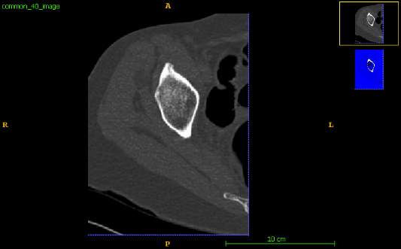
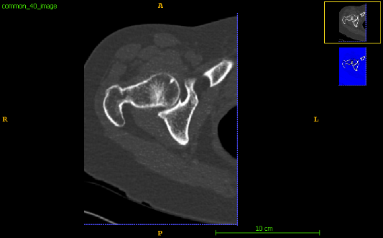
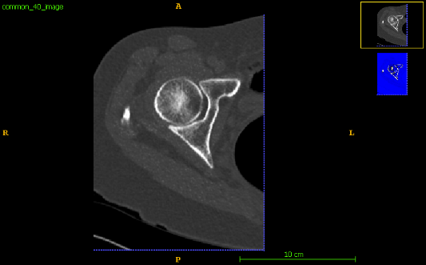
Femur head presence prediction along z-slices
NON-EXIST
0
VECTORIZATION
(combine all binary data into z-slices-long vector)
Femur presence vector (as training data)
EXIST
1
1
EXIST

Slide 10
Femur head presence prediction along z-slices
Classifier (Support Vector Machine)
Femur presence vector (as training data)
Specified Classifier
Image features as additional training data
(such as Pixel intensity, perimeter, center of mass)

Slide 11
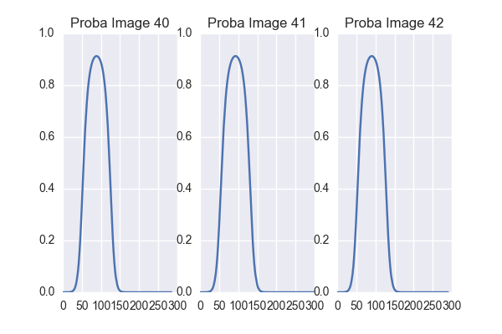
Femur head presence prediction along z-slices
Specified Classifier
Output1
Probability plot
Output 2
The slice with largest probability of femur presence
Test data (individual image from ‘common’ image sets)

Slide 12
Results 1: normalized position

Slide 13
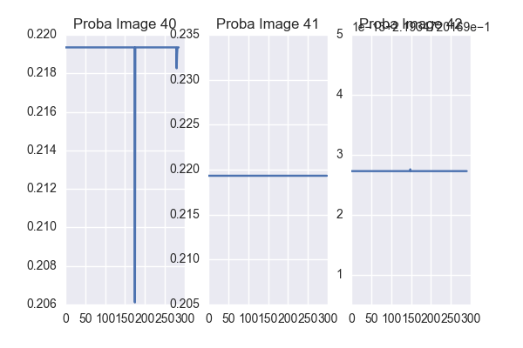
Results 2: normalized position + center of mass + perimeter sum + max intensity

Slide 14
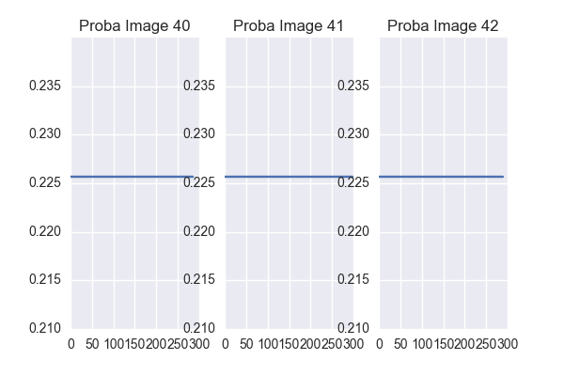
Results 3: pixels intensity

Slide 15
Conclusion
Requirements:
Good atlas creation
Good image registration
Good choice of features

Slide 16
Thank you for your attention

